Slide 1
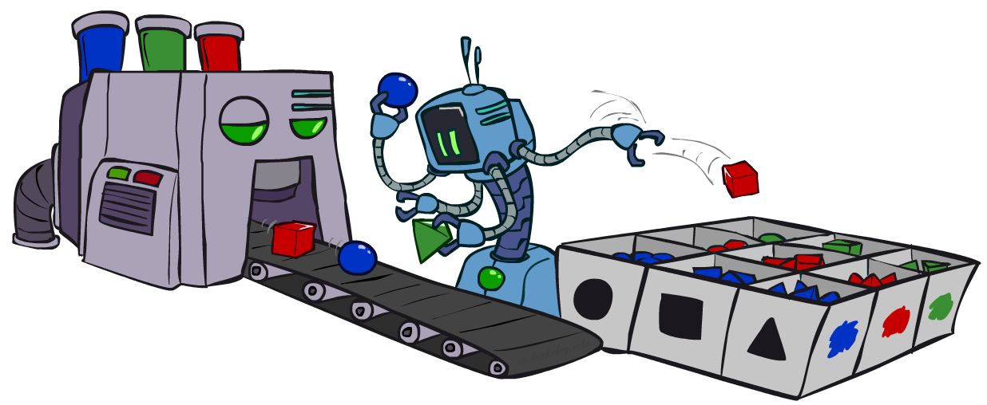
Artificial Intelligence
Bayes’ Nets: Sampling
Instructors: David Suter and Qince Li
Course Delivered @ Harbin Institute of Technology
[Many slides adapted from those created by Dan Klein and Pieter Abbeel for CS188 Intro to AI at UC Berkeley. Some others from colleagues at Adelaide University.]
Notes:
Please retain proper attribution, including the reference to ai.berkeley.edu. Thanks!

Slide 2
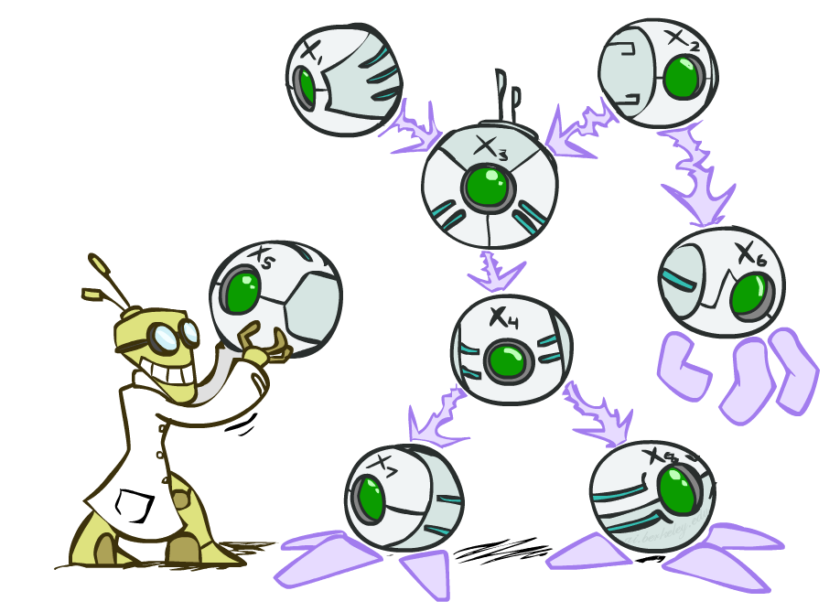
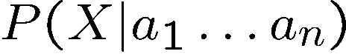
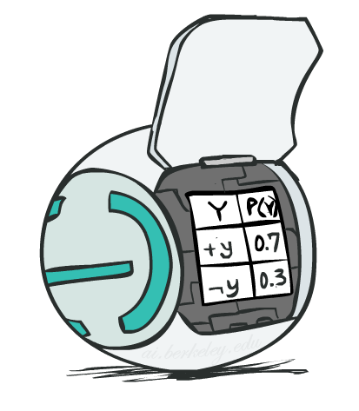
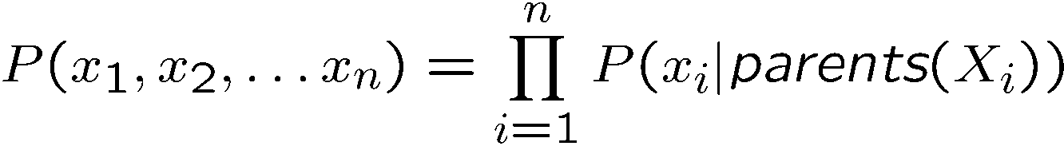
Bayes’ Net Representation
A directed, acyclic graph, one node per random variable
A conditional probability table (CPT) for each node
A collection of distributions over X, one for each combination of parents’ values
Bayes’ nets implicitly encode joint distributions
As a product of local conditional distributions
To see what probability a BN gives to a full assignment, multiply all the relevant conditionals together:

Slide 3
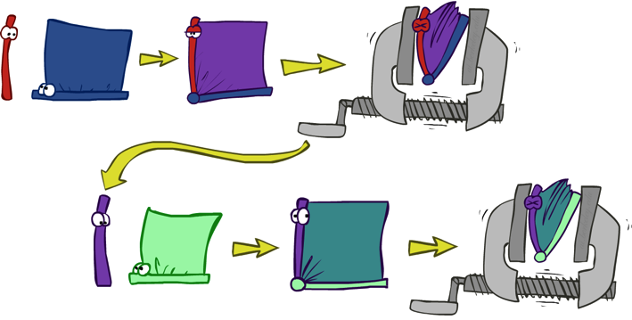
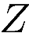
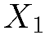
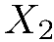
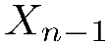
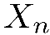
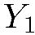
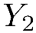
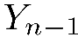
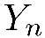
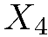
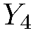
Variable Elimination
Interleave joining and marginalizing
d^{k} entries computed for a factor over k variables with domain sizes d
Ordering of elimination of hidden variables can affect size of factors generated
Worst case: running time exponential in the size of the Bayes’ net
…
…

Slide 4
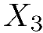
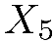
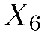
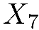

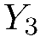
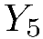
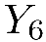
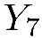
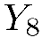
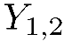
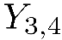
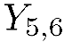
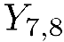
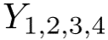
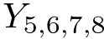
Worst Case Complexity?
CSP:
If we can answer P(z) equal to zero or not, we answered whether the 3-SAT problem has a solution.
Hence inference in Bayes’ nets is NP-hard. No known efficient probabilistic inference in general.
…
…

Slide 5

Approximate Inference: Sampling

Slide 6

Sampling
Sampling is a lot like repeated simulation
Predicting the weather, basketball games, …
Basic idea
Draw N samples from a sampling distribution S
Compute an approximate posterior probability
Show this converges to the true probability P
Why sample?
Learning: get samples from a distribution you don’t know
Inference: getting a sample is faster than computing the right answer (e.g. with variable elimination)

Slide 7
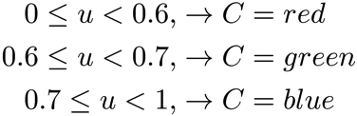

Sampling
Sampling from given distribution
Step 1: Get sample u from uniform distribution over [0, 1)
E.g. random() in python
Step 2: Convert this sample u into an outcome for the given distribution by having each outcome associated with a sub-interval of [0,1) with sub-interval size equal to probability of the outcome
Example
If random() returns u = 0.83, then our sample is C = blue
E.g, after sampling 8 times:
C | P(C)
red | 0.6
green | 0.1
blue | 0.3

Slide 8
Sampling in Bayes’ Nets
Prior Sampling
Rejection Sampling
Likelihood Weighting
Gibbs Sampling

Slide 9
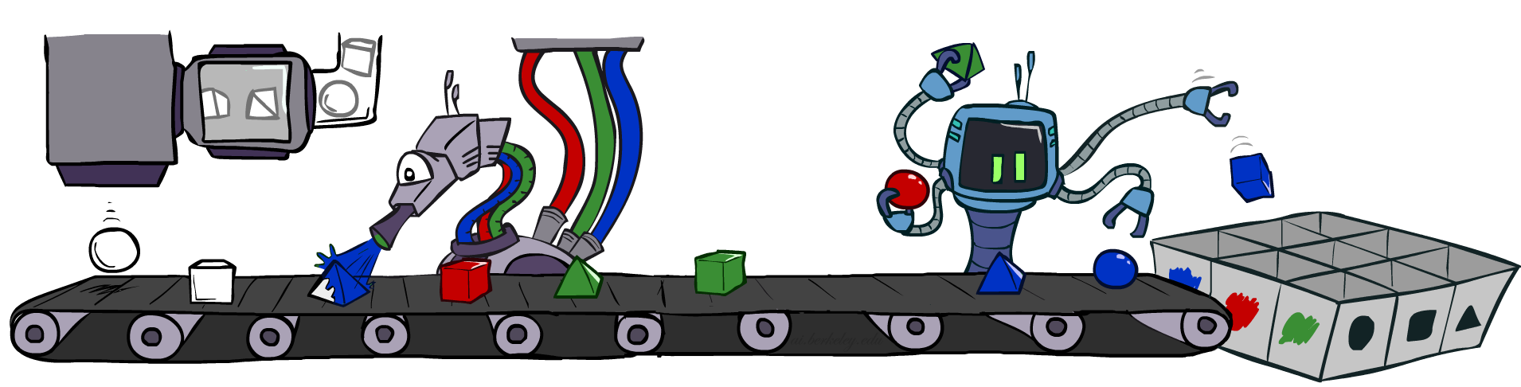
Prior Sampling

Slide 10
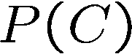
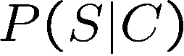
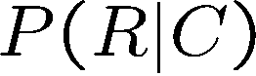
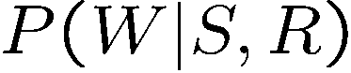
Prior Sampling
+c | 0.5
-c | 0.5
Cloudy
Cloudy
+c | +s | 0.1
 | -s | 0.9
-c | +s | 0.5
 | -s | 0.5
+c | +r | 0.8
 | -r | 0.2
-c | +r | 0.2
 | -r | 0.8
Sprinkler
Sprinkler
Rain
Rain
WetGrass
WetGrass
Samples:
+s | +r | +w | 0.99
 |  | -w | 0.01
 | -r | +w | 0.90
 |  | -w | 0.10
-s | +r | +w | 0.90
 |  | -w | 0.10
 | -r | +w | 0.01
 |  | -w | 0.99
+c, -s, +r, +w
-c, +s, -r, +w
…

Slide 11
Prior Sampling
For i=1, 2, …, n
Sample x_{i} from P(X_{i} | Parents(X_{i}))
Return (x₁, x₂, …, x_{n})

Slide 12
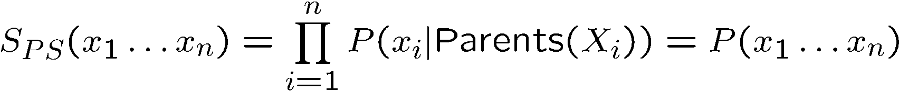
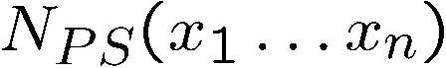
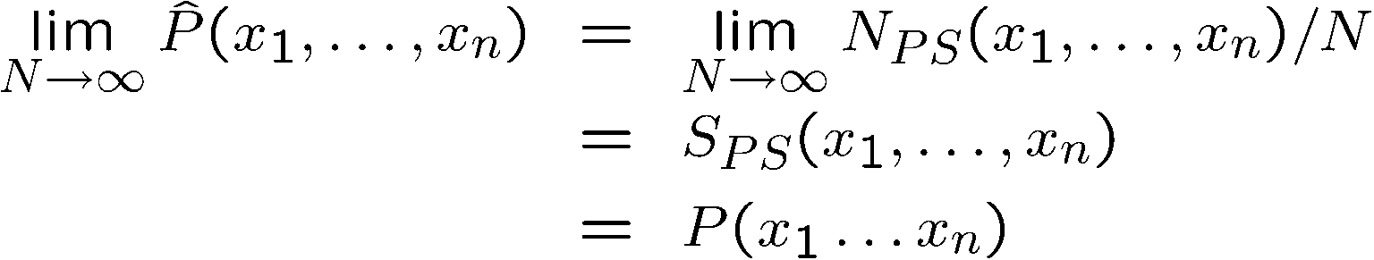
Prior Sampling
This process generates samples with probability:
…i.e. the BN’s joint probability
Let the number of samples of an event be
Then
I.e., the sampling procedure is consistent

Slide 13
Example
We’ll get a bunch of samples from the BN:
+c, -s, +r, +w
+c, +s, +r, +w
-c, +s, +r, -w
+c, -s, +r, +w
-c, -s, -r, +w
If we want to know P(W)
We have counts <+w:4, -w:1>
Normalize to get P(W) = <+w:0.8, -w:0.2>
This will get closer to the true distribution with more samples
Can estimate anything else, too
What about P(C| +w)? P(C| +r, +w)? P(C| -r, -w)?
Fast: can use fewer samples if less time (what’s the drawback?)
C
S
R
W

Slide 14
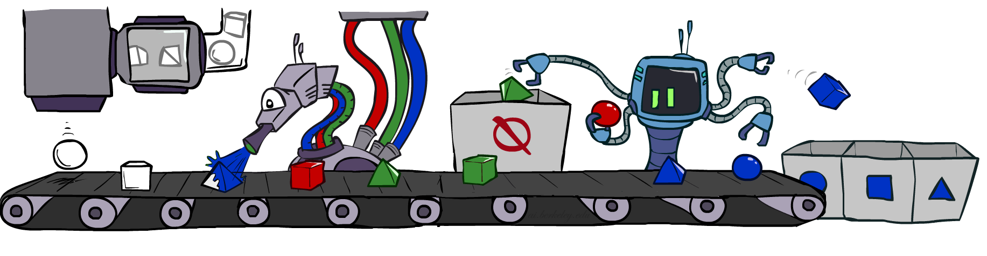
Rejection Sampling

Slide 15
Rejection Sampling
Let’s say we want P(C)
No point keeping all samples around
Just tally counts of C as we go
Let’s say we want P(C| +s)
Same thing: tally C outcomes, but ignore (reject) samples which don’t have S=+s
This is called rejection sampling
It is also consistent for conditional probabilities (i.e., correct in the limit)
C
S
R
W
+c, -s, +r, +w
+c, +s, +r, +w
-c, +s, +r, -w
+c, -s, +r, +w
-c, -s, -r, +w

Slide 16
Rejection Sampling
IN: evidence instantiation
For i=1, 2, …, n
Sample x_{i} from P(X_{i} | Parents(X_{i}))
If x_{i} not consistent with evidence
Reject: Return, and no sample is generated in this cycle
Return (x₁, x₂, …, x_{n})

Slide 17
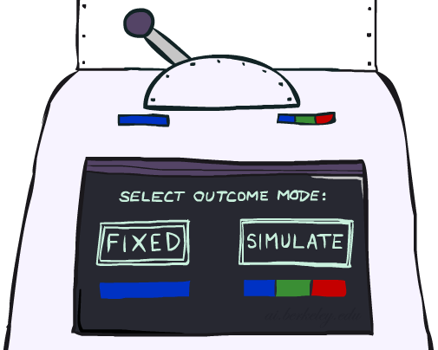
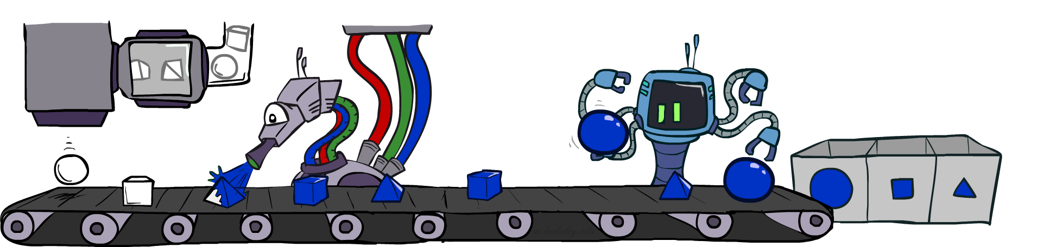
Likelihood Weighting

Slide 18
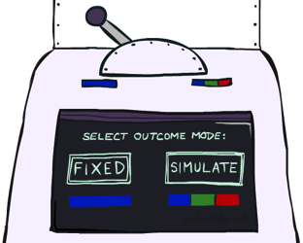


Likelihood Weighting
Problem with rejection sampling:
If evidence is unlikely, rejects lots of samples
Evidence not exploited as you sample
Consider P(Shape|blue)
Idea: fix evidence variables and sample the rest
Problem: sample distribution not consistent!
Solution: weight by probability of evidence given parents
pyramid, green
pyramid, red
sphere, blue
cube, red
sphere, green
pyramid, blue
pyramid, blue
sphere, blue
cube, blue
sphere, blue
Shape
Color
Shape
Color

Slide 19
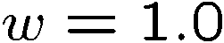
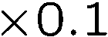
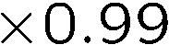
Likelihood Weighting
+c | 0.5
-c | 0.5
Cloudy
Cloudy
+c | +s | 0.1
 | -s | 0.9
-c | +s | 0.5
 | -s | 0.5
+c | +r | 0.8
 | -r | 0.2
-c | +r | 0.2
 | -r | 0.8
Sprinkler
Sprinkler
Rain
Rain
WetGrass
Samples:
WetGrass
+s | +r | +w | 0.99
 |  | -w | 0.01
 | -r | +w | 0.90
 |  | -w | 0.10
-s | +r | +w | 0.90
 |  | -w | 0.10
 | -r | +w | 0.01
 |  | -w | 0.99
+c, +s, +r, +w
…

Slide 20
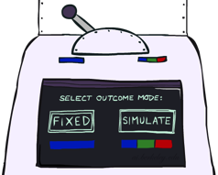
Likelihood Weighting
IN: evidence instantiation
w = 1.0
for i=1, 2, …, n
if X_{i} is an evidence variable
X_{i} = observation x_{i} for X_{i}
Set w = w * P(x_{i} | Parents(X_{i}))
else
Sample x_{i} from P(X_{i} | Parents(X_{i}))
return (x₁, x₂, …, x_{n}), w

Slide 21
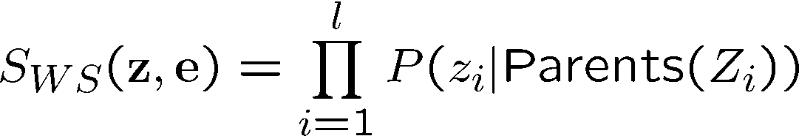



Likelihood Weighting
Sampling distribution if z sampled and e fixed evidence
Now, samples have weights
Together, weighted sampling distribution is consistent
Cloudy
C
S
R
W

Slide 22

Likelihood Weighting
Likelihood weighting is good
We have taken evidence into account as we generate the sample
E.g. here, W’s value will get picked based on the evidence values of S, R
More of our samples will reflect the state of the world suggested by the evidence
Likelihood weighting doesn’t solve all our problems
Evidence influences the choice of downstream variables, but not upstream ones (C isn’t more likely to get a value matching the evidence)
We would like to consider evidence when we sample every variable
→ Gibbs sampling

Slide 23

Gibbs Sampling *

Slide 24
Gibbs Sampling *
Procedure: keep track of a full instantiation x₁, x₂, …, x_{n}. Start with an arbitrary instantiation consistent with the evidence. Sample one variable at a time, conditioned on all the rest, but keep evidence fixed. Keep repeating this for a long time.
Property: in the limit of repeating this infinitely many times the resulting sample is coming from the correct distribution
Rationale: both upstream and downstream variables condition on evidence.
In contrast: likelihood weighting only conditions on upstream evidence, and hence weights obtained in likelihood weighting can sometimes be very small. Sum of weights over all samples is indicative of how many “effective” samples were obtained, so want high weight.

Slide 25
Gibbs Sampling Example: P( S | +r) *
Step 1: Fix evidence
R = +r
Steps 3: Repeat
Choose a non-evidence variable X
Resample X from P( X | all other variables)
Step 2: Initialize other variables
Randomly
C
C
S
+r
S
+r
W
W
C
C
C
C
C
C
S
+r
S
+r
S
+r
S
+r
S
+r
S
+r
W
W
W
W
W
W

Slide 26

Efficient Resampling of One Variable *
C
Sample from P(S | +c, +r, -w)
Many things cancel out – only CPTs with S remain!
More generally: only CPTs that have resampled variable need to be considered, and joined together
S
+r
W

Slide 27





Bayes’ Net Sampling Summary
Prior Sampling P
Likelihood Weighting P( Q | e)
Rejection Sampling P( Q | e )
Gibbs Sampling P( Q | e ) *

Slide 28
Further Reading on Gibbs Sampling*
Gibbs sampling produces sample from the query distribution P( Q | e ) in limit of re-sampling infinitely often
Gibbs sampling is a special case of more general methods called Markov chain Monte Carlo (MCMC) methods
Metropolis-Hastings is one of the more famous MCMC methods (in fact, Gibbs sampling is a special case of Metropolis-Hastings)
You may read about Monte Carlo methods – they’re just sampling

Slide 29
Markov Chain Monte Carlo*
Idea: instead of sampling from scratch, create samples that are each like the last one.
Procedure: resample one variable at a time, conditioned on all the rest, but keep evidence fixed. E.g., for P(b|c):
Properties: Now samples are not independent (in fact they’re nearly identical), but sample averages are still consistent estimators!
What’s the point: both upstream and downstream variables condition on evidence.
+b
+a
+c
-b
+a
+c
-b
-a
+c

Slide 30

Artificial Intelligence
Decision Networks and Value of Perfect Information
[These slides were created by Dan Klein, Pieter Abbeel, and Anca. http://ai.berkeley.edu.]
Notes:
Please retain proper attribution, including the reference to ai.berkeley.edu. Thanks!

Slide 31

Video of Demo Ghostbuster – No probability

Slide 32
Video of Demo Ghostbusters with Probability

Slide 33

Decision Networks

Slide 34




Decision Networks
Umbrella
U
Weather
Forecast
Notes:
There exists a ghostbusters demo

Slide 35
Decision Networks
MEU: choose the action which maximizes the expected utility given the evidence
Can directly operationalize this with decision networks
Bayes nets with nodes for utility and actions
Lets us calculate the expected utility for each action
New node types:
Chance nodes (just like BNs)
Actions (rectangles, cannot have parents, act as observed evidence)
Utility node (diamond, depends on action and chance nodes)
Umbrella
U
Weather
Forecast
Notes:
There exists a ghostbusters demo

Slide 36
Decision Networks
Action selection
Instantiate all evidence
Set action node(s) each possible way
Calculate posterior for all parents of utility node, given the evidence
Calculate expected utility for each action
Choose maximizing action
Umbrella
U
Weather
Forecast
Notes:
There exists a ghostbusters demo

Slide 37




Maximum Expected Utility
Umbrella = leave
Umbrella
U
Umbrella = take
Weather
A | W | U(A,W)
leave | sun | 100
leave | rain | 0
take | sun | 20
take | rain | 70
W | P(W)
sun | 0.7
rain | 0.3
Optimal decision = leave
Notes:
There exists a ghostbusters demo

Slide 38






Decisions as Outcome Trees
{}
take
leave
Umbrella
Weather | {}
Weather | {}
U
sun
sun
Weather
rain
rain
U(t,s)
U(t,r)
U(l,s)
U(l,r)
Almost exactly like expectimax / MDPs
What’s changed?

Slide 39


Maximum Expected Utility
Umbrella = leave
A | W | U(A,W)
leave | sun | 100
leave | rain | 0
take | sun | 20
take | rain | 70
Umbrella
U
Weather
W | P(W|F=bad)
sun | 0.34
rain | 0.66
Forecast
=bad

Slide 40

Maximum Expected Utility
Umbrella = leave
A | W | U(A,W)
leave | sun | 100
leave | rain | 0
take | sun | 20
take | rain | 70
Umbrella
U
Umbrella = take
Weather
W | P(W|F=bad)
sun | 0.34
rain | 0.66
Optimal decision = take
Forecast
=bad

Slide 41

Decisions as Outcome Trees
Umbrella
{b}
take
leave
U
W | {b}
W | {b}
Weather
sun
sun
rain
rain
U(t,s)
U(t,r)
U(l,s)
U(l,r)
Forecast
=bad

Slide 42
Ghostbusters Decision Network
Demo: Ghostbusters with probability
Bust
U
Ghost Location
…
Sensor (1,1)
Sensor (1,2)
Sensor (1,3)
Sensor (1,n)
Sensor (2,1)
…
…
…
Sensor (m,1)
Sensor (m,n)

Slide 43

Value of Information

Slide 44

Value of Information
Idea: compute value of acquiring evidence
Can be done directly from decision network
Example: buying oil drilling rights
Two blocks A and B, exactly one has oil, worth k
You can drill in one location
Prior probabilities 0.5 each, & mutually exclusive
Drilling in either A or B has EU = k/2, MEU = k/2
Question: what’s the value of information of O?
Value of knowing which of A or B has oil
Value is expected gain in MEU from new info
Survey may say “oil in a” or “oil in b,” prob 0.5 each
If we know OilLoc, MEU is k (either way)
Gain in MEU from knowing OilLoc?
VPI(OilLoc) = k/2
Fair price of information: k/2
D | O | U
a | a | k
a | b | 0
b | a | 0
b | b | k
DrillLoc
U
O | P
a | 1/2
b | 1/2
OilLoc

Slide 45


Value of Perfect Information
MEU with no evidence
Umbrella
A | W | U
leave | sun | 100
leave | rain | 0
take | sun | 20
take | rain | 70
U
MEU if forecast is bad
Weather
MEU if forecast is good
Forecast
Forecast distribution
F | P(F)
good | 0.59
bad | 0.41

Slide 46



Value of Information
{+e}
Assume we have evidence E=e. Value if we act now:
Assume we see that E’ = e’. Value if we act then:
BUT E’ is a random variable whose value is
unknown, so we don’t know what e’ will be
Expected value if E’ is revealed and then we act:
Value of information: how much MEU goes up
by revealing E’ first then acting, over acting now:
a
P(s | +e)
U
{+e, +e’}
a
P(s | +e, +e’)
U
{+e}
P(+e’ | +e)
P(-e’ | +e)
{+e, +e’}
{+e, -e’}
a

Slide 47





VPI Properties
Nonnegative
Nonadditive
(think of observing E_{j} twice)
Order-independent
Notes:
Usually second evidence less informative
Opposite can also happen: XOR; knowing x1 not useful, knowing x2 not useful, knowing both useful

Slide 48



Quick VPI Questions
The soup of the day is either clam chowder or split pea, but you wouldn’t order either one. What’s the value of knowing which it is?
There are two kinds of plastic forks at a picnic. One kind is slightly sturdier. What’s the value of knowing which?
You’re playing the lottery. The prize will be $0 or $100. You can play any number between 1 and 100 (chance of winning is 1%). What is the value of knowing the winning number?

Slide 49
VPI Question
VPI(OilLoc) ?
VPI(ScoutingReport) ?
VPI(Scout) ?
VPI(Scout | ScoutingReport) ?
Generally:
If Parents(U) Z | CurrentEvidence
Then VPI( Z | CurrentEvidence) = 0
DrillLoc
U
Scout
OilLoc
Scouting
Report

Slide 50
习题：一辆车的车况可能有好（Q=+q）有坏（Q=-q），所以二手车收购员购买车前需要进行不同的测试（测试可能需要花费一定费用），然后依据不同的测试结果决定是否购买。假设一个收购员买车的时候时间只够进行一项测试（需花费300元），这项测试能够帮助他弄清楚车的车况。测试的结果可能是T：通过（T=pass）或没通过（T=fail）。一辆车c的。 价值是1万5千元，而如果车况好的市场价值是2万元，如果车况不好，需要花7千元修理费把车调整到好的车况。据估计，c车车况好的概率是70%。
如果不做测试，买车c所期望得到的净收入是多少？
假设测试结果的概率分布如下。
P(T=pass | Q=+q) = 0.9
P(T=pass | Q=-q) = 0.2
计算车辆通过/不通过检测的概率，以及测试后车况好坏的概率。
3.计算测试后的最优化方案，以及期望的收益。
4.计算测试的VPI，并决定是不是应该做测试。

